Slide 1
Google Image Downloader
Team:
Anmol Jindal
anmoljindal0709@gmail.com
Arsh Deep Singh
sarshdeep89@gmail.com

Slide 2
Introduction:
The Google image downloader is a webapp to download images from google in bulk.
It not only downloads but has an option for resize and converting to gray scale also.
The processed images are compressed in a zip file.
The client receives a link on their mail by opening the link they can download their zip file

Slide 3
Working:
The client first enters a keyword related to which they want he images
Then the number of images they want to download
The app asks the client whether he/she wants to convert the images to grayscale
The app then asks for the percentage by which they want to resize the image.
The client enters his/her email-id
The images are downloaded and processed in the background and saved into a zip file
The client then receives an E-mail with a link which contains the zip file containg the processed images

Slide 4
Languages and Libraries used:
Python
os
zipFile
cv2
flask
HTML

Slide 5
FrameworK and driver Used:
Flask
Flask
redirect
url_for
request
render_template
send_file
Flask_mail
Gecko Driver
It is used for downloading images from Mozilla Firefox

Slide 6
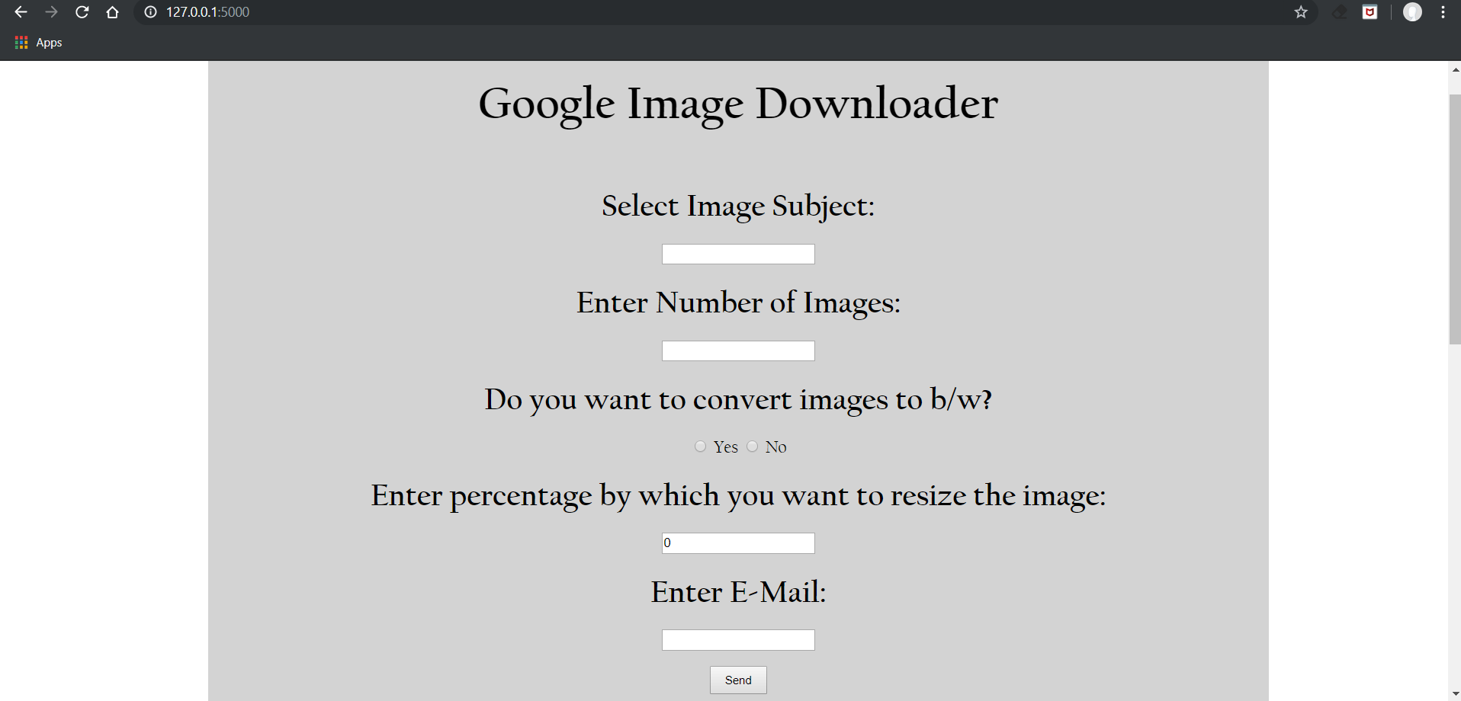

Slide 7
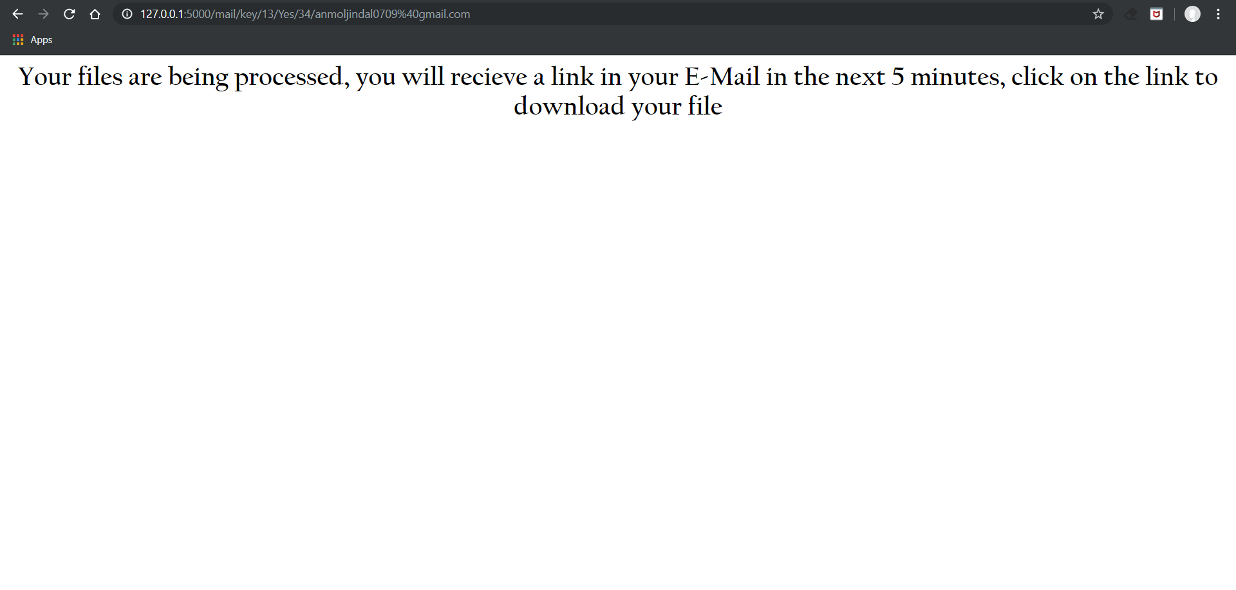

Slide 8
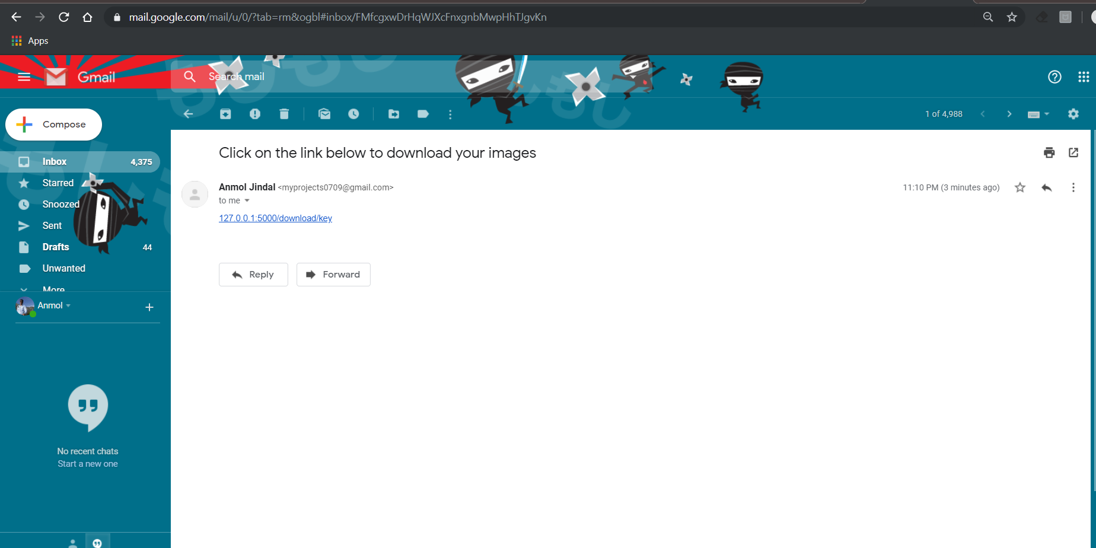

Slide 9
Thank YOU

